Slide 1

Transcriptomics Series:
🧬 Single-cell analysis with Seurat
June 24, 2025

Slide 2
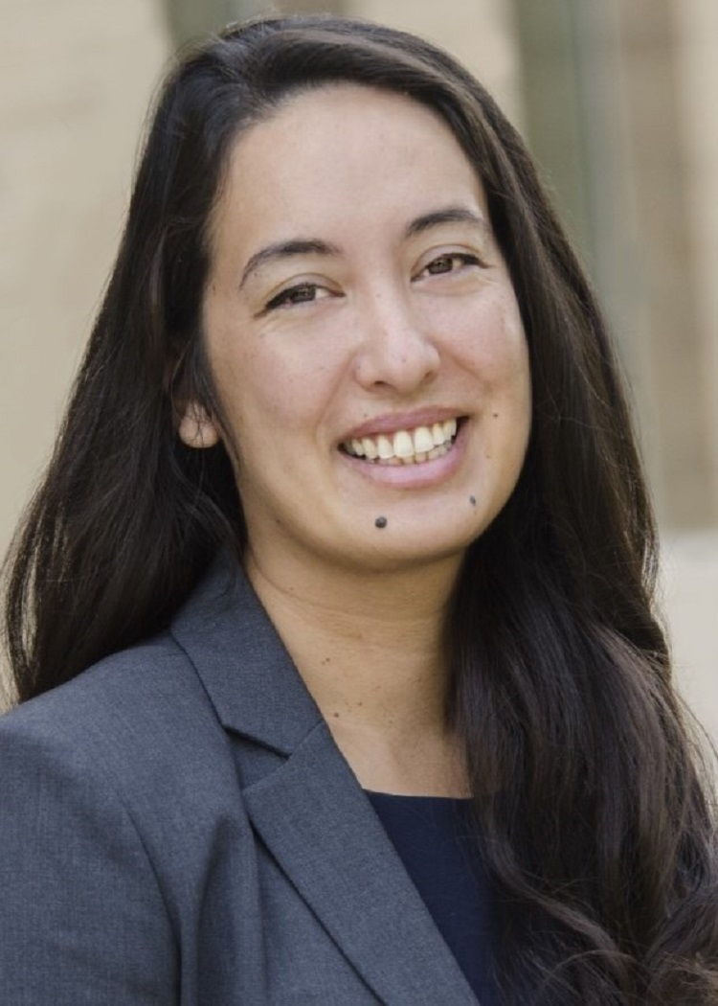
Transcriptomics Series:
🧬 Single-cell analysis with Seurat
Today’s Speaker:
Natalie Davidson, PhD
Assistant Professor
Division of Reproductive Sciences
Department of Obstetrics and Gynecology

Slide 3

Today’s sponsor
The Lozupone lab combines bioinformatics and experimental work to understand the driving factors of human microbiota composition, host:microbe interactions, and the intersection with diet in a variety of disease contexts. Our work has a particular focus on HIV, cancer and Clostridioides difficile infection.​

Slide 4

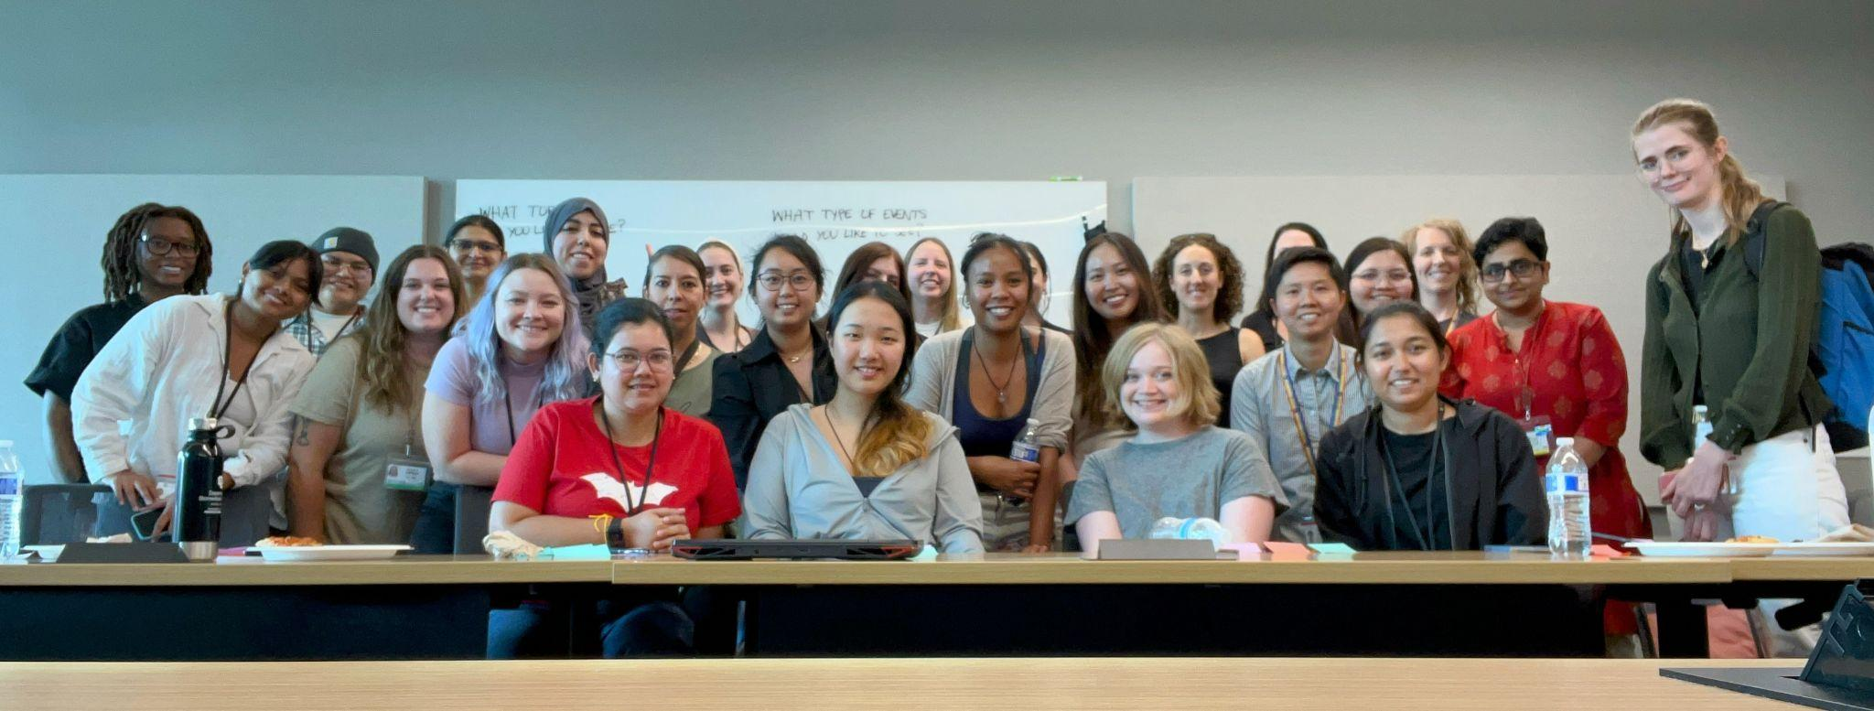
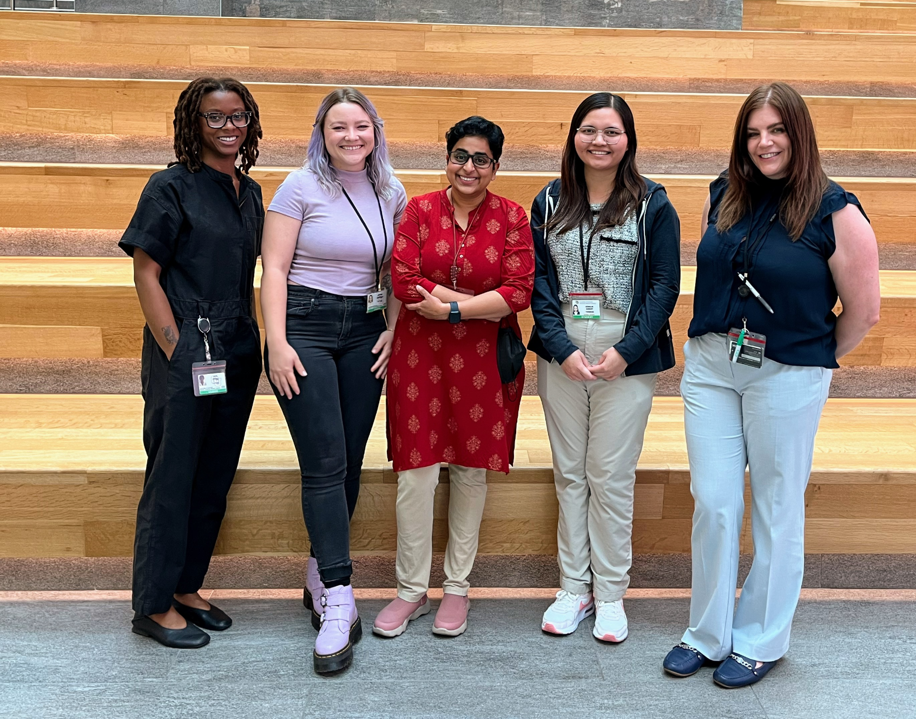
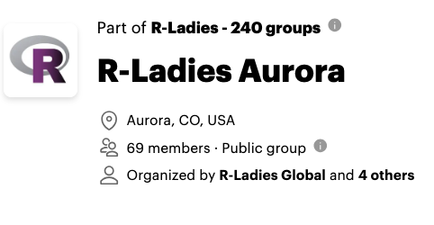
Who We R!?
R-Ladies Kick-off Event on Jul 25, 2024
RLA 2024 Co-organizer team: Jade, Keenan, Janani, Kewalin, Stacey (left to right)

Slide 5

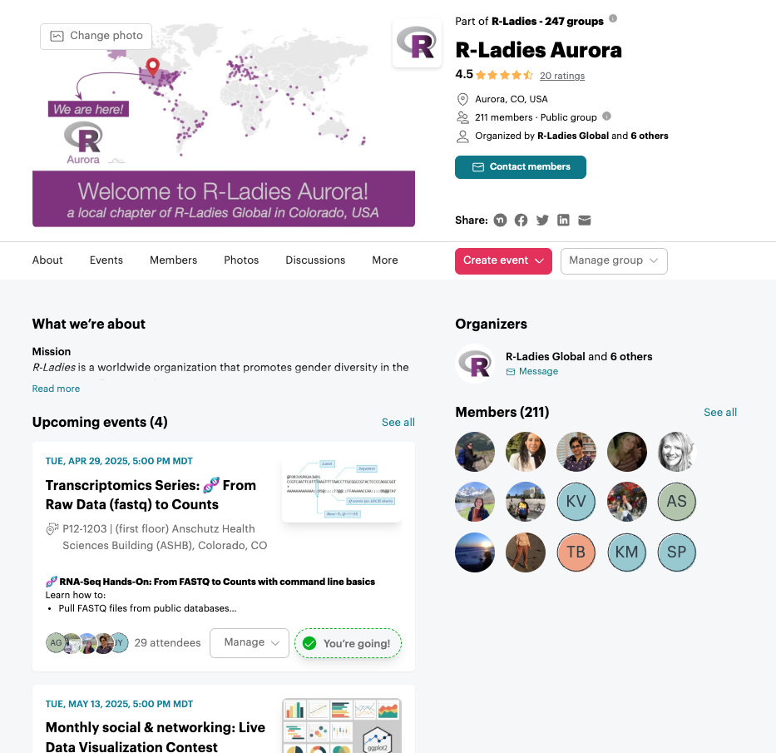
New Members?
1. Join us, RSVP for events on Meetup
https://www.meetup.com/rladies-aurora/
2. Join our discussion forum on Discord
https://bit.ly/RLA-discord

Slide 6


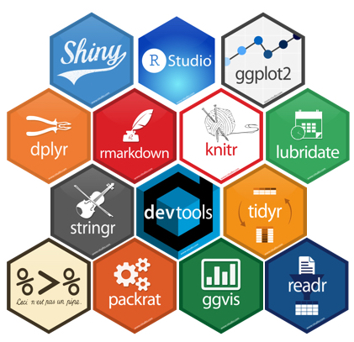
2025 Workshops
Monthly social + networking events
Python in R
Transcriptomics series
Data wrangling with transcriptomics
From Raw Data (fastq) to Counts
Single-cell RNAseq analysis with Seurat (today!)
RLA’s year in review
Differential gene expression analysis

Slide 7

Today! June 24, 2025
Introduction to single-cell RNA seq data
Overview of Seurat package
Data Visualization
Ping us on Discord with any Questions –

